Slide 1
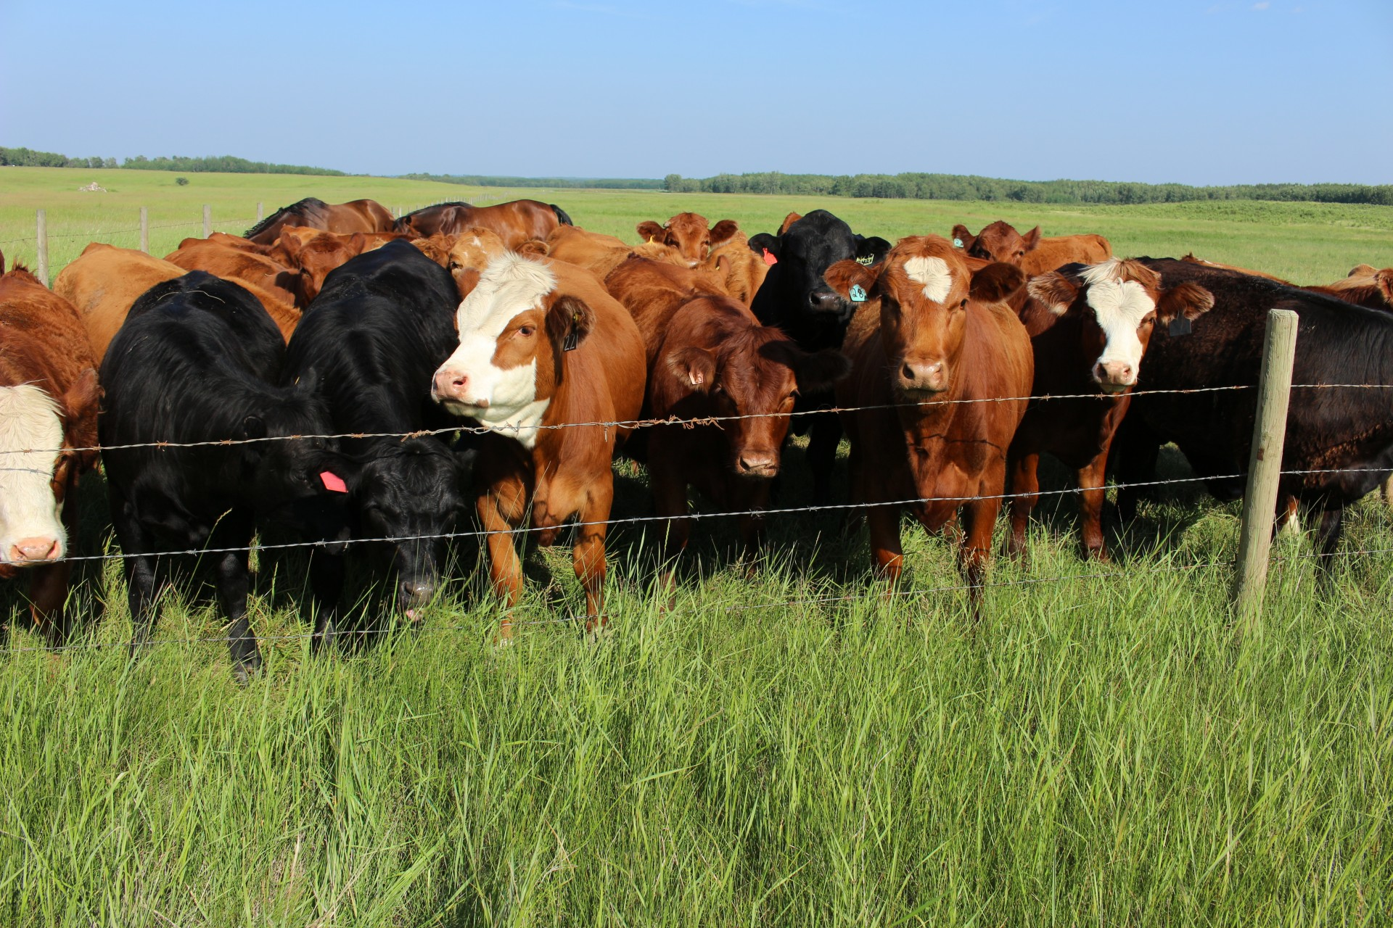
Studying the Microbial Community Interactions of Sri Lankan Milk Microbiota For Different Cattle Breeds and Lactation Phases
Name: M.A. Udara
Email : 2018s16765@stu.cmb.ac.lk
Degree: Bioinformatics Hons.

Slide 2
Challenges
Microbiome data are compositional. Microbial counts represent proportions instead of absolute abundances.
Sparsity in the dataset can lead to false associations of microorganisms. A zero indicates either the absence of a microorganism, or an insufficient sequencing depth.
It is challenging to differentiate between direct and indirect associations

Slide 3
Number of Samples for each Variable
Lactation Phases
Phase | Number of Samples
Early Phase | 32
Mid Phase | 18
Late Phase | 11
Dry Phase | 02
Cattle Breeds
Breed | Number of Samples
FJC Breed | 12
FC Breed | 04
SC Breed | 02
JSC Phase | 19
Breed | Number of Samples
BC Breed | 04
FSC Breed | 02
AFS Breed | 02
JC Breed | 06
Breed | Number of Samples
S Breed | 02
A Breed | 01
J Breed | 05

Slide 4
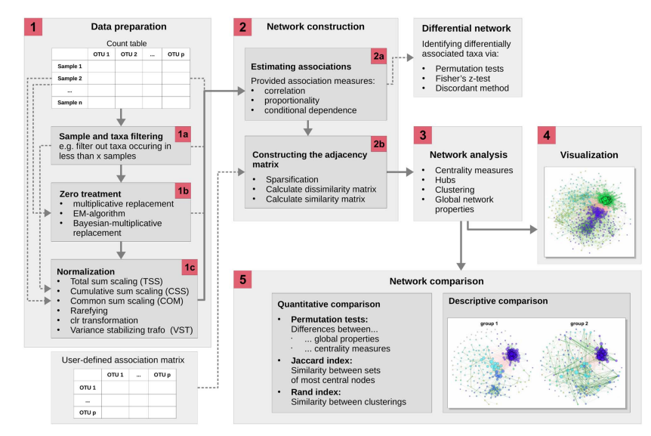
Workflow Proposed by NetCoMi

Slide 5
Microbial Co-occurrence Network Construction Methods
Methods
Correlation-based methods
Spearman correlation
Pearson correlation
Conditional dependence methods
gCoda
SparCC
CCLasso
SPIEC-EASI
SPRING
Correlation Based Methods:
Log-transformed variants of Pearson or Spearman correlation to obtain an estimate of microbial interaction between pairs of taxa
Conditional Dependence Based Methods:
Correlation based methods typically fail to differentiate between direct and indirect associations. To account for this, a plethora of methods have been developed to model conditional dependence.

Slide 6
SparCC
Sparse Correlations for Compositional data
SparCC is based on an iterative approximation approach and uses log-ratio transformed data to infer the correlations between the components.
Assumptions: underlying networks are large-scale and sparse.
SparCC was shown to be better suited to avoid spurious correlations compared to direct Pearson correlations at the cost of higher computational complexity

Slide 7
SparCC
Network Analysis
props_single_Early <- netAnalyze(net_single_Early,
clustMethod = "cluster_fast_greedy",
hubPar = "eigenvector",
hubQuant = 0.95)
Network Construction
net_single_Early <- netConstruct(Early_data,
verbose = 3,
filtTax = "highestFreq",
filtTaxPar = list(highestFreq = 100),
# filtTax = "none",
# filtTaxPar = "totalReads",
filtSamp = "totalReads",
filtSampPar = list(totalReads = 1000),
zeroMethod = "none", normMethod = "none",
measure = "sparcc",
sparsMethod = "threshold", thresh = 0.4,
dissFunc = "signed",
seed = 123456)
Network Visualization
p_Early <- plot(props_single_Early,
shortenLabels = "none",
# labelLength = 16,
# charToRm = "g__",
labelScale = FALSE,
rmSingles = "all",
nodeSize = "eigenvector",
nodeColor = "cluster",
hubBorderCol = "blue",
cexNodes = 1,
cexLabels = 0.5,
edgeWidth = 1,
highlightHubs = TRUE,
cexHubs = 1.5,
# cexHubLabels = 2,
title1 = "Early Phase Network on Family level with SparCC Method.",
showTitle = TRUE,
cexTitle = 1.5)

Slide 8
SPRING
Semi-Parametric Rank-based approach for INference in Graphical model approach .
Applicable both to quantitative and relative abundance data.
In SPRING, the correlation matrix is estimated via a semi-parametric rank-based correlation estimator.
The data are assumed to follow a truncated Gaussian copula model.
The latent correlation matrix is estimated using Kendall’s τ and element-wise univariate optimization of an inverse copula function.
Sparse conditional dependencies are then inferred using the neighborhood selection approach using the latent correlation estimate.
SPRING introduces a modified clr transformation (mclr) that does not require pseudo counts.

Slide 9
SPRING
Network Analysis
props_single_Early <- netAnalyze(net_single_Early,
clustMethod = "cluster_fast_greedy",
hubPar = "eigenvector",
hubQuant = 0.95)
Network Construction
net_single_Early_Spring <- netConstruct(Early_data, verbose = 3,
filtTax = "highestFreq",
filtTaxPar = list(highestFreq = 100),
#filtTax = "none",
#filtTaxPar = "totalReads",
filtSamp = "totalReads",
filtSampPar = list(totalReads = 1000),
zeroMethod = "none", normMethod = "none",
measure = "spring",
measurePar = list(nlambda = 20,
rep.num = 20,
thresh = 0.1,
subsample.ratio = 0.8, # 10*sqrt(n)/n for n > 144
lambda.min.ratio = 0.01,
lambdaseq = "data-specific",
ncores=1),
sparsMethod = "none", dissFunc = "signed",
seed = 123456)
Network Visualization
p_Early <- plot(props_single_Early,
shortenLabels = "none",
# labelLength = 16,
# charToRm = "g__",
labelScale = FALSE,
rmSingles = "all",
nodeSize = "eigenvector",
nodeColor = "cluster",
hubBorderCol = "blue",
cexNodes = 1,
cexLabels = 0.5,
edgeWidth = 1,
highlightHubs = TRUE,
cexHubs = 1.5,
# cexHubLabels = 2,
title1 = "Early Phase Network on Family level with SparCC Method.",
showTitle = TRUE,
cexTitle = 1.5)

Slide 10
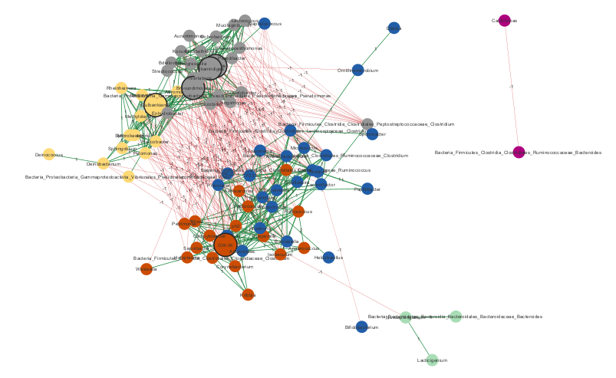
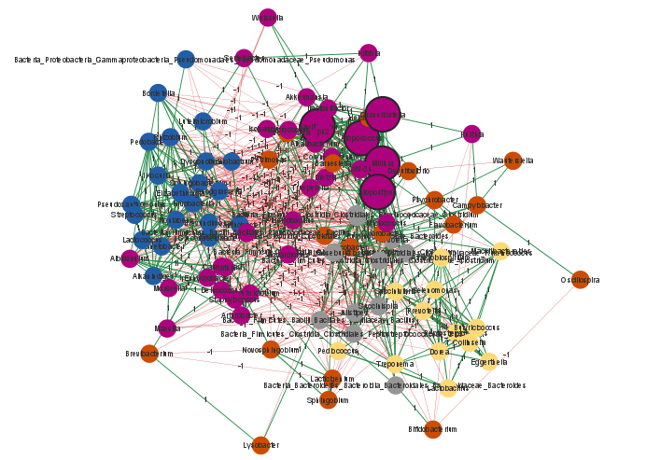
Results: SparCC
1. Early Phase
2. Mid Phase

Slide 11
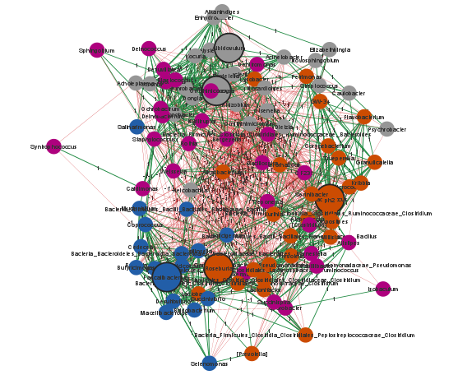
3. Late Phase
Resulted Keystone Species in SparCC method for Lactation Phases
Phase | Keystone Species
Early | Alkanindiges
 | Pedobacter
 | Brevundimonas
 | GW-34
 | Gulbenkiania
Mid | Papillibacter
 | Millisia
 | Granulicatella
 | Atopostipes
 | Atopococcus
Late | Beutenbergia
 | Albidovulum
 | Roseburia
 | Faecalibacterium
 | Macrococcus

Slide 12
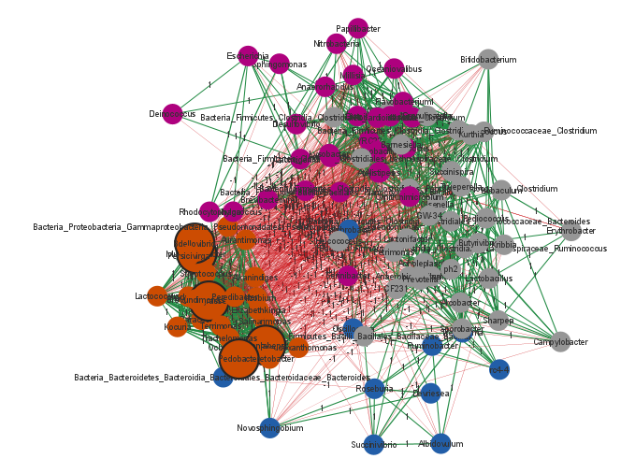
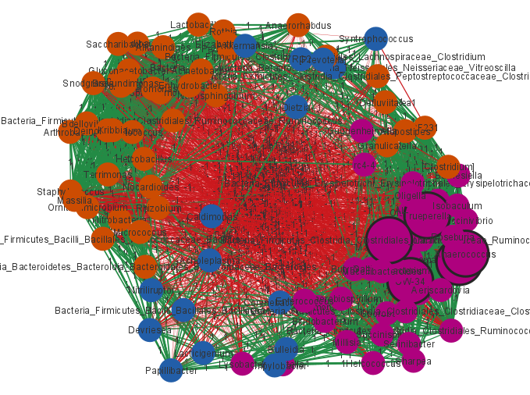
4. FJC Breed
5. FC Breed

Slide 13
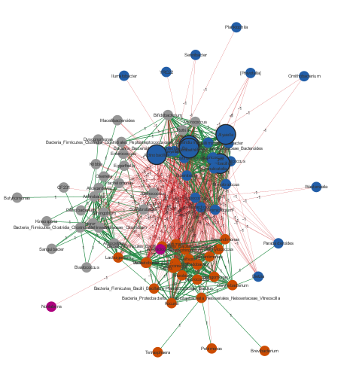
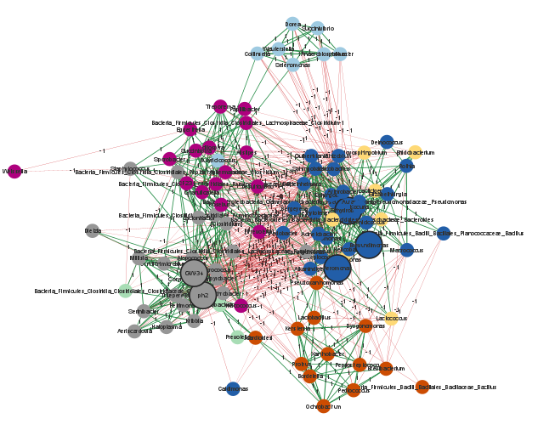
6. JSC Breed
7. BC Breed

Slide 14
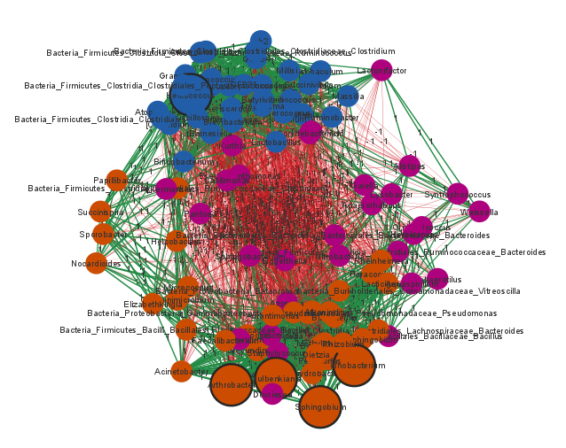
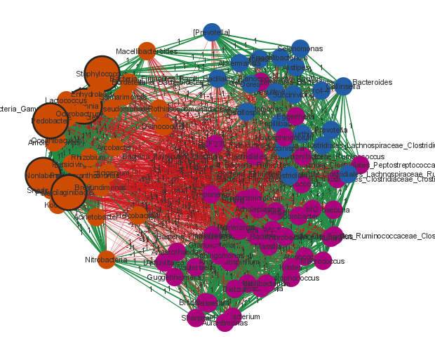
8. JC Breed
9. J Breed

Slide 15
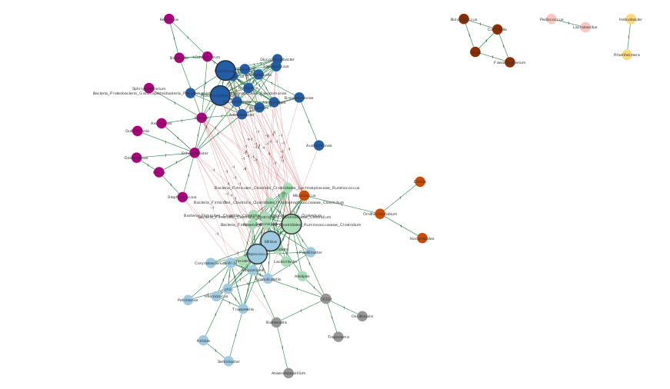
10. Total Genus Level Network

Slide 16
Resulted Keystone Species in SparCC method for Cattle Breeds
FJC | Bdellovibrio
 | Mucilaginibacter
 | Snodgrassella
 | Pedobacter
 | Nonlabens
JSC | GW-34
 | ph2
 | Brevundimonas
 | Aeromonas
 | Enhydrobacter
BC | Helcobacillus
 | Actinobacillus
 | Bacteria_Bacteroidetes_Bacteroidia_Bacteroidales_Bacteroidaceae_Bacteroides
 | Psychrobacter
 | Alysiella
J | Leifsonia
 | Staphylococcus
 | Mucilaginibacter
 | Pedobacter
 | Nonlabens

Slide 17
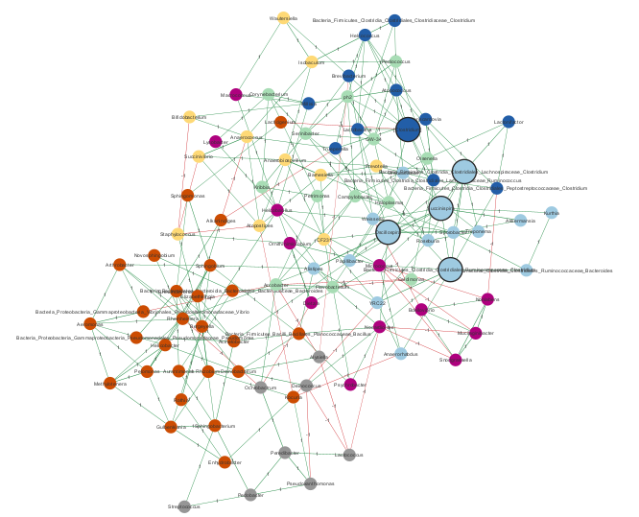
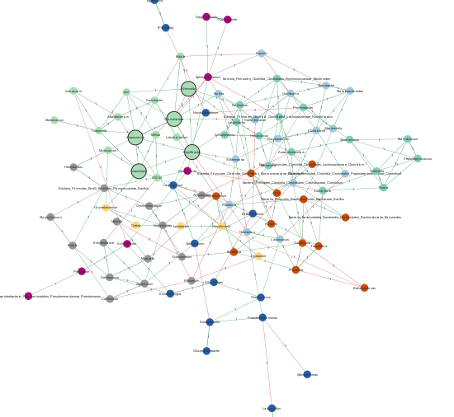
Results: SPRING
1. Early Phase
2. Mid Phase

Slide 18
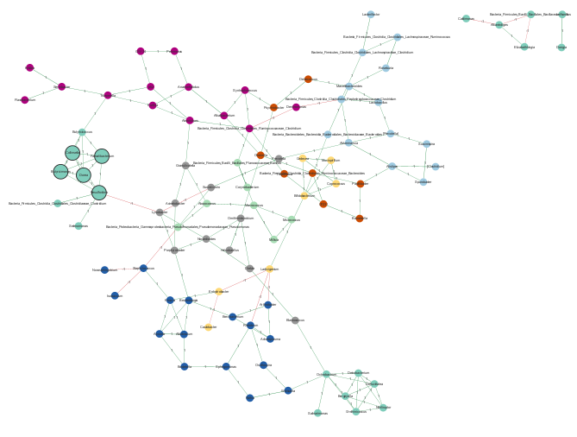
3. Late Phase
Resulted Keystone Species in SPRING method for Lactation Phases
Phase
Early
Mid
Late
Keystone Species
Micrococcus
Succinispira
Bacteria_Firmicutes_Clostridia_Clostridiales_Ruminococcaceae_Clostridium
Bacteria_Firmicutes_Clostridia_Clostridiales_Lachnospiraceae_Clostridium
Oscillospira
Atopococcus
Atopostipes
Granulicatella
Weissella
Papillibacter
Faecalibacterium
Collinsella
Dorea
Desulfovibrio
Butyricimonas

Slide 19
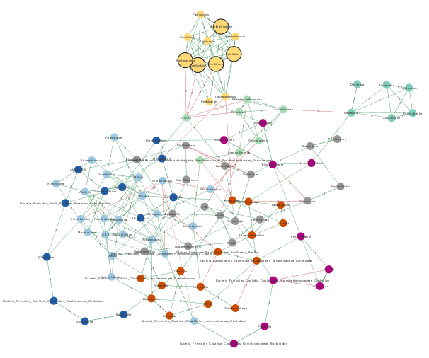
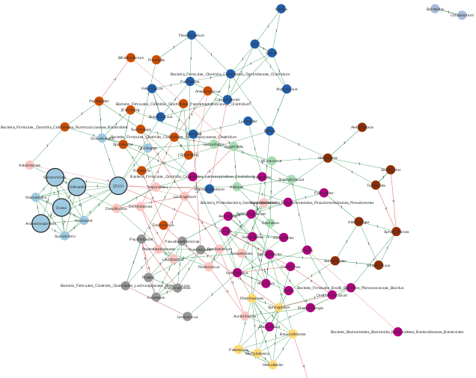
4. FJC Breed
5. JSC Breed

Slide 20
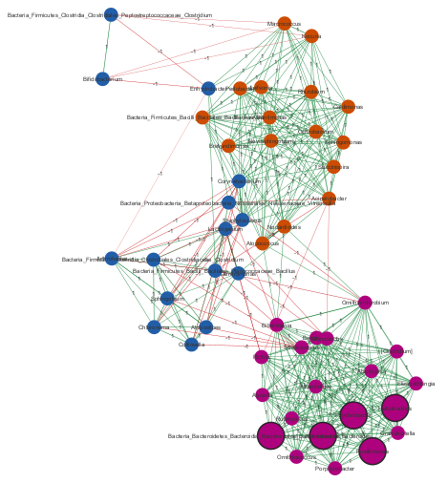
6. BC Breed
Resulted Keystone Species in SPRING method for Cattle Breed
Breed
FJC
JSC
BC
Keystone species
Nonlabens
Snodgrassella
Mucilaginibacter
Bdellovibrio
Peredibacter
CF231
Collinsella
Dorea
Selenomonas
Anaerobiospirillum
Psychrobacter
Bacteria_Bacteroidetes_Bacteroidia_Bacteroidales_Bacteroidaceae_Bacteroides
Actinobacillus
Helcobacillus
Pusillimonas

Slide 21
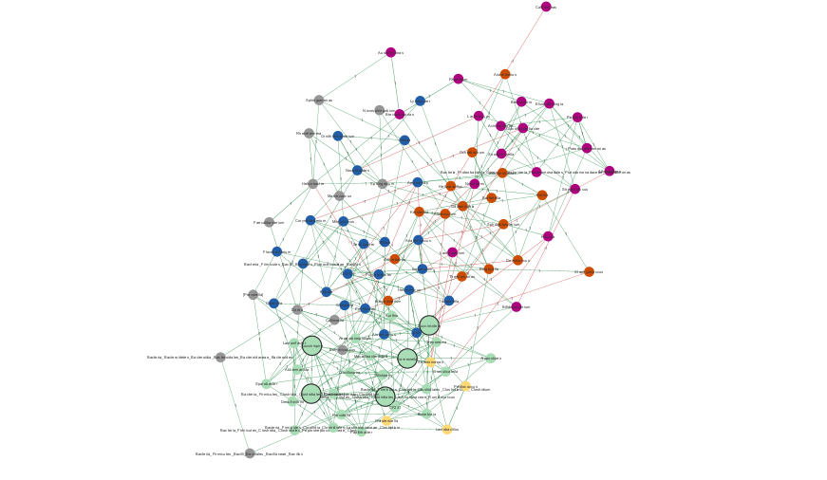
7. Total Genus Level Network

Slide 22
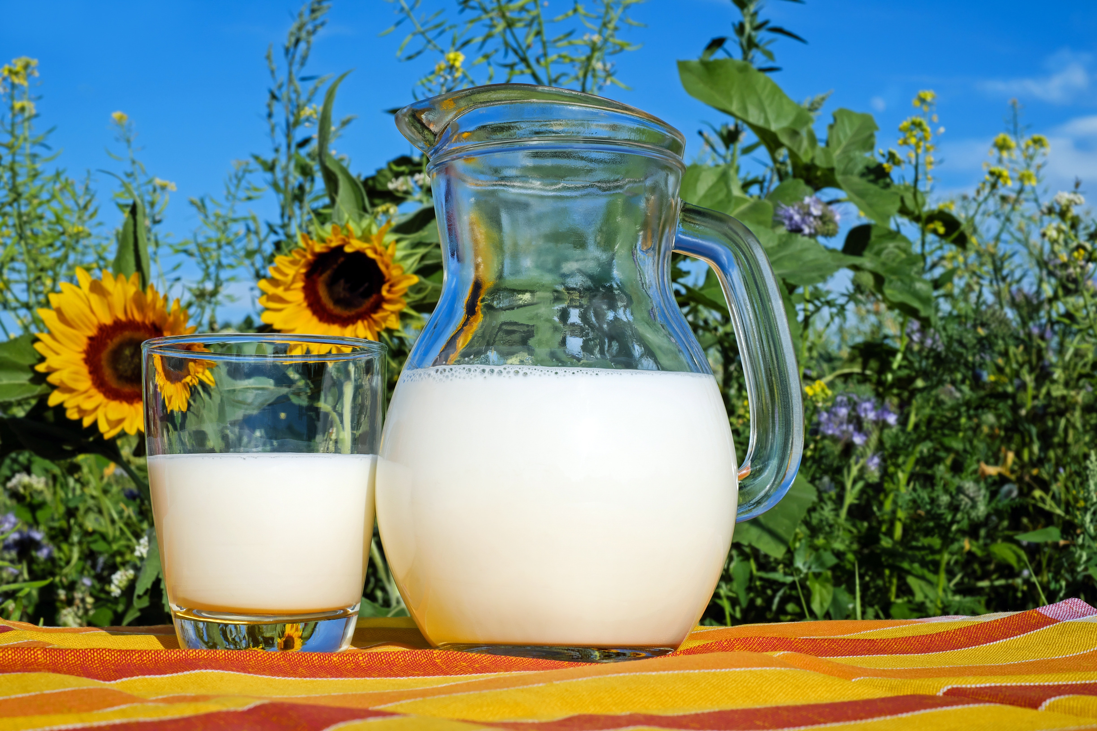
Thank you!
Any Questions?

